Slide 1


SUSTAINABILITY AWARD
SUSTAINABILITY AWARD CORE AREAS
THE SUSTAINABILITY AWARD
The Sustainability Award, led by the King Khalid Foundation and project partner AccountAbility, aims to help businesses strengthen their competitiveness while enhancing their environmental, social and governance performance. The Award focuses on aligning sustainability practices with business imperatives, such as promoting positive growth, improving reputation, and enabling engagement with key stakeholders.
Building on its eleven-year legacy, the 2019 Sustainability Award will boast the largest pool of applicants to date and recognizes the Kingdom’s leading businesses in sustainability. The Award has previously attracted many of the Kingdom’s high-profile companies, with past winners including Huawei, the Arabian Drilling Company, the Saudi Investment Bank, Binzagr Unilever Limited, the National Commercial Bank (NCB), Cisco and the National Petrochemical Industrial Company (NATPET).
Through participating in the Award, applicants gain a better understanding of which sustainability strategies can enhance investor and stakeholder interest, and increase bottom lines and competitive advantages. Applicants are provided with a customized Scorecard Report presenting an overview of their performance, and identifying gaps and opportunities to improve their business. Furthermore, participants become a part of a KSA-wide network of key business leaders within the Kingdom.
The Sustainability Award methodology involves a self-completion questionnaire consisting of 64 questions, which are categorized into five core areas. The scoring process includes sector-adjusted weighting across the five themes for different sectors and industries.
BUILDING A NATIONALLY COMPETITIVE WORKFORCE
INNOVATING SOLUTIONS FOR SUSTAINABLE DEVELOPMENT
EMPOWERING LOCAL SUPPLIERS
MAKING A COMMITMENT TO GOOD GOVERNANCE AND HIGH QUALITY
RESPONSIBLE ENVIRONMENTAL MANAGEMENT
KEY BENEFITS OF SUSTAINABILITY
Improved reputation and brand loyalty
Increased competitive advantage against industry peers
Increased productivity and reduced costs
Improved risk management and efficiency
Attraction of employees and investors
Reduced waste
Improved social and environmental footprint
Mitigation of negative impacts
Social and economic development
* Participation to the Award of free of cost.

Slide 2
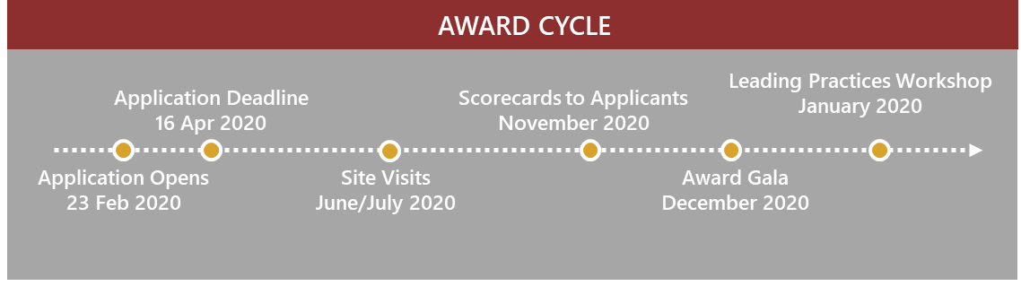
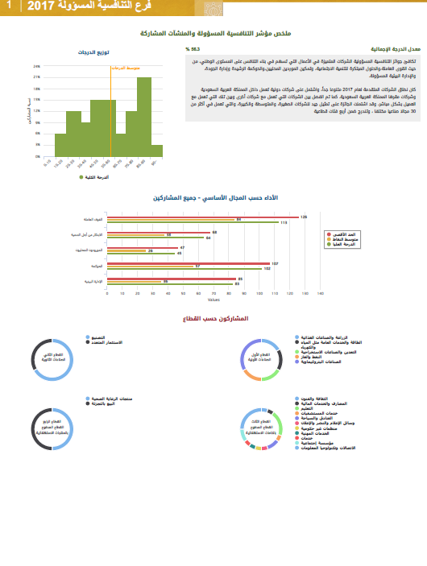
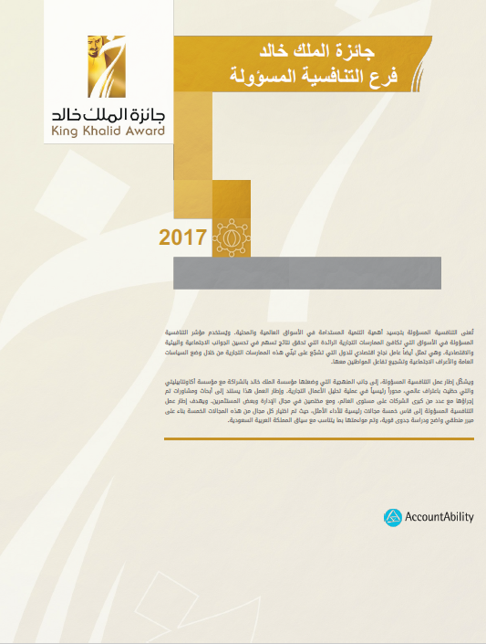
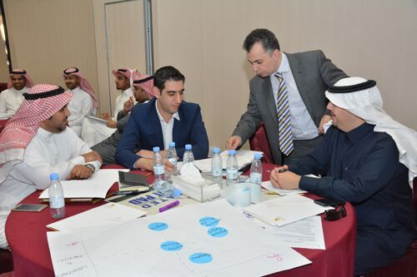
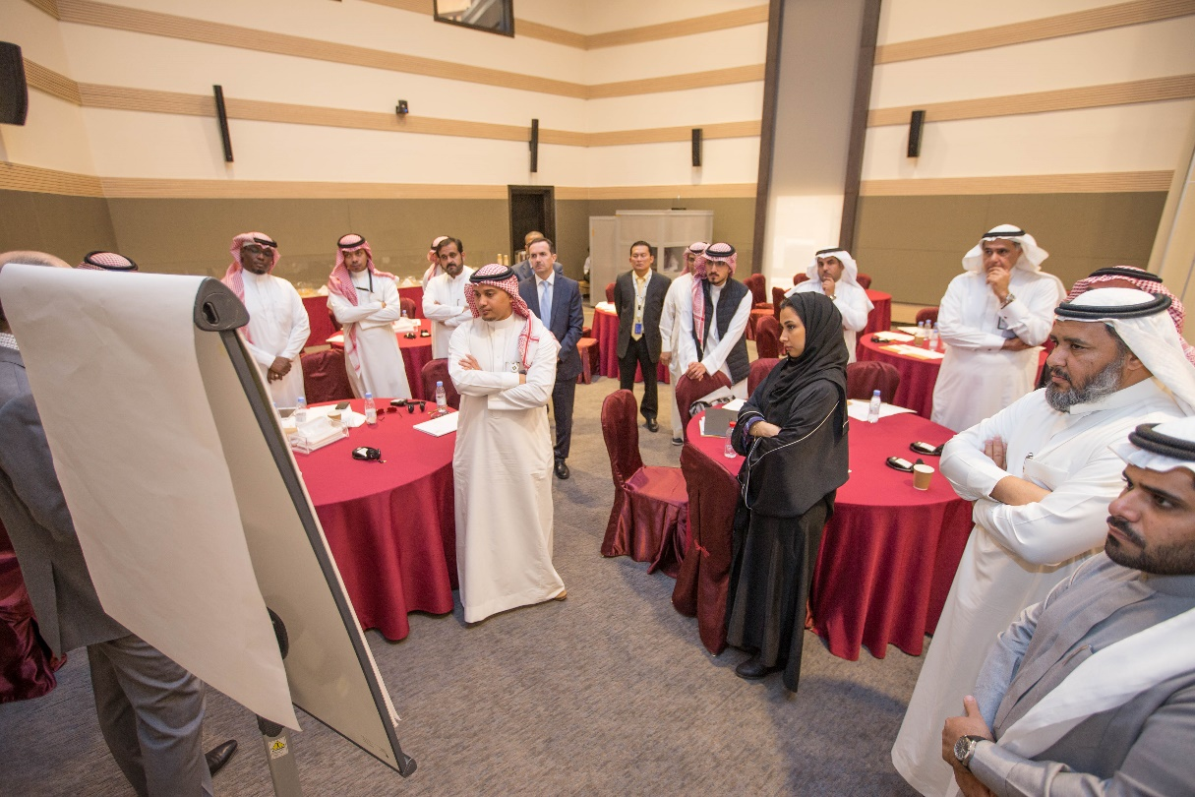
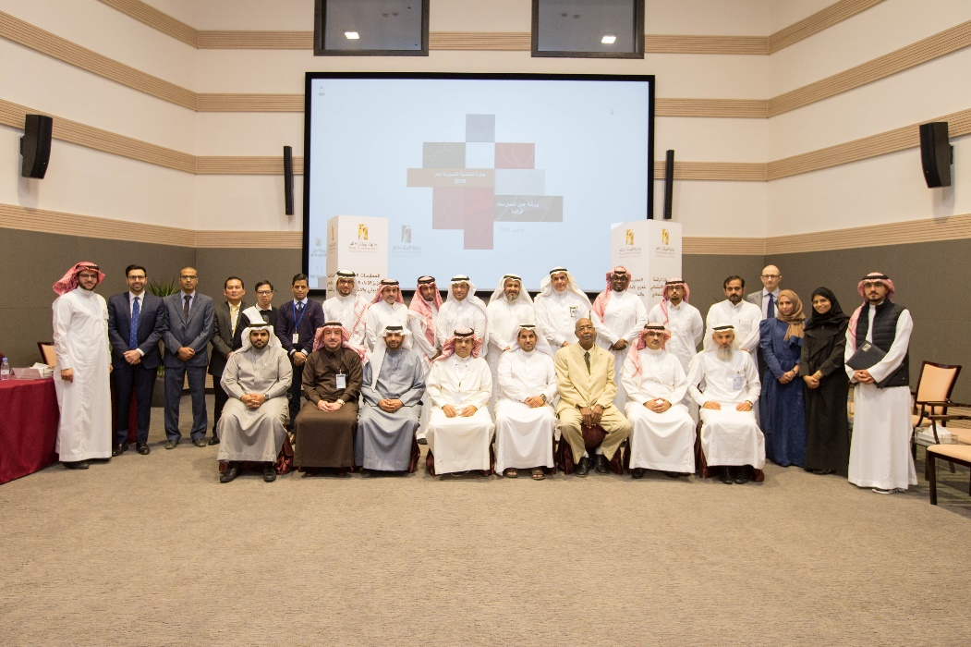
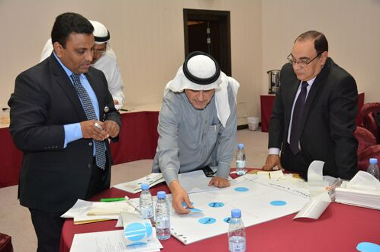
Online Application
Winners Recognition
Site Visits
Leading Practices Workshop
Online application with questionnaire assessed against five core areas, as presented above.
Top scoring applicants progress to site visit phase. The Award team visits company facilities.
Winners receive King Khalid Award and are honored by His Majesty King Salman bin Abdulaziz.
Applicants receive individualized Scorecards and are invited to LP Workshop, to learn about leading sustainability practices.
CUSTOMIZED ANALYSIS AND SCORECARDS
LEADING PRACTICES WORKSHOP
All Sustainability Award applicants receive tailored analysis of their sustainability performance, as well as overall recommendations for improvements with supporting industry references.
Participants have the opportunity to learn emerging and leading practices from peers and sustainability experts, and have the chance to discuss their performance and scorecards during one-on-one sessions.

Slide 3
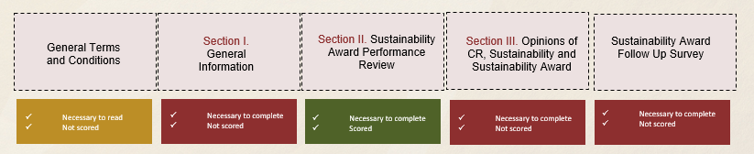
APPLICATION STRUCTURE*
Building a Nationally Competitive Workforce
Equality and Diversity in the Workplace
Commitment to Good Governance and High Quality
Commitment to Good Governance
Responsible Environmental Management
Workforce Development
6 questions
3 questions
7 questions
Ethics and Protection
2 questions
Commitment to High Quality
5 questions
Innovating Solutions for Sustainable Development
Sustainability Innovation
2 questions
Community Investment and Strategic Programs
2 questions
Empowering
Local Suppliers
Responsible Supply Chain Management
5 questions
Supporting Local Suppliers
3 questions
Environmental Management
2 questions
Resource Management
6 questions
Waste Management
1 question
Performance Management
3 questions
Health and Safety Performance
4 questions
Sustainability Award Score
Industry Sector Specific Weighting
SECTION II (Main area scored)
Sustainability Performance Areas
* More information found in the Applicant Handbook.

Slide 4




SUPPORT SERVICES FOR APPLICANTS*
APPLICATION SUPPORT
WEBINARS
The King Khalid Foundation and project partner AccountAbility offer one-on-one applicant support, via individual sessions to answer questions and provide guidance in terms of completing the application.
Applicants can inquire for an individual conference call with the AccountAbility analyst team during the application period, from February to April.
Join our online webinars, offered during the application period, to learn more about the Award’s process and contents, and assessment methodology.
Visit the Award timeline section, available on the Resource Center, for information on the specific dates the webinars are hosted
APPLICATION COMPLETENESS REVIEW
SCORECARD REVIEW SESSION
The Application Completeness Review check provides applicants with an assessment of how complete their application is, and offers:
Review of the questionnaire’s completeness
Final check to make sure the application has been properly filled out
Supporting documentation has been successfully submitted
Highlight any missing data and supporting documentation
We encourage all applicants to get in touch with the Award team to schedule a dedicated session to go through their Scorecard Reports, and discuss the key areas for improvement.
Scorecard sessions are offered either the day of the Leading Practices Workshop, or remotely via conference calls.
* No fee required for the provision of the support services.

Slide 5




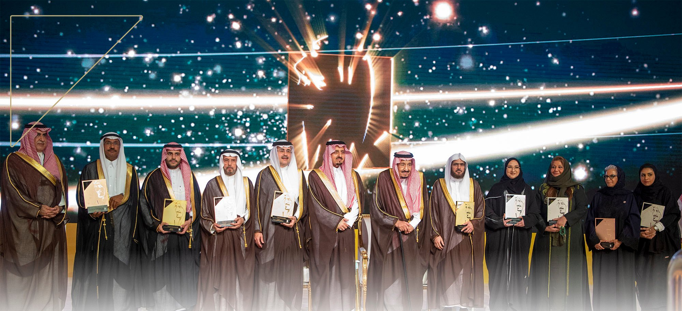
The 2020 Application will remain open from February 23rd to April 16th, 2020, and is accessible through the KKF website
KEEP IN TOUCH
SUSTAINABILITY AWARD RESOURCE CENTER
Visit our Resource Center for further resources, information on the process & timeline, and online webinars hosted.
SUSTAINABILITY AWARD NEWSLETTER
Subscribe to our Sustainability Award Newsletter, to remain up to date with our Sustainability Award news and case studies.
APPLICATION SUPPORT
Contact us directly for any questions regarding the Sustainability Award or your application.
Mr. Yasser AlHarbi
King Khalid Award Program Supervisor
y.alharbi@kkf.org.sa
CONTACT INFORMATION
AccountAbility Representative
kkf@accountability.org

